Slide 1
The ACT of Self-Forgiveness
A Principles-Based Response to Intrapersonal Offence
Workshop
Grant Dewar, Peter Strelan, Paul Delfabbro
Notes:
The ACT of Self Forgiveness: A Principles-Based Response to Intrapersonal Offence
Self-forgiveness has been demonstrated to be beneficial for both psychological and social wellbeing. RFT and ACT reveals that language in and of itself creates, suffering and attendant struggle with burdens of shame, guilt remorse, and regret.
All will experience these phenomena. Struggle creates the internal arena in which self-blame flourishes, but may also provide a place of opportunity to develop effective responses regarding self-forgiveness. This workshop demonstrates a, novel approach to self-forgiveness focused on the forgiveness of self for intrapersonal transgressions against the self. The therapeutic approach describes seven principles which include: identification of the burden; taking a transcendent perspective; identification of personal values and identification transgressions against those values; ACT therapeutic responses; granting self-forgiveness; putting values into action; making an ongoing commitment to self-forgiveness.
Participants will be provided with a principles-based framework, promoting self-forgiveness to clients and possible client populations which may be beneficial recipients of targeted therapy
Educational Objectives:
1. Analyze a novel approach to self-forgiveness focused on the forgiveness of self for intrapersonal transgressions against the self.
2. Describe the therapeutic approach and its seven principles which include: identification of the burden; taking a transcendent perspective; identification of personal values and identification transgressions against those values; ACT therapeutic responses; granting self-forgiveness; putting values into action; making an ongoing commitment to self-forgiveness.
3. Explain a principles-based framework, promoting self-forgiveness to clients and possible client populations which may be beneficial recipients of targeted therapy.

Slide 2
ACT of Self Forgiveness Why?
Completing the Circle - Self Forgiveness Community and ACBS
Building an evidence-based set of principles for treatment of distress
Providing useful therapeutic pathways based on self-compassion, ACT/RFT
ACT with Self-forgiveness is the lapis philosophorum - the philosophers stone that turns base metal (Regret… etc ) into gold ( a renewed life)
Notes:
The work we have carried out in the ACT of self-forgiveness joins the theoretical framework being developed by the community of self-forgiveness researchers with contextual behavioural science. Both have been developing since the 1990s in parallel.
We conceptualise self-forgiveness as an action oriented and restorative sequence of behaviours that occurs in the arena of self-compassion.
Recent literature highlights the need for the development of evidence-based approaches for individual therapy for those who blame themselves unworkably for life setbacks and for intrapersonal transgressions.
Also - the major interventions in self-forgiveness developed to date for group therapeutic approaches are mostly based on Christian literature.
We believe that a principles-based approach using contextual behavioural science can provide a useful workable and relatively simple approach to implementing the principles of self-forgiveness in trans diagnostic settings and for individual and group therapy.
We believe the principles can be usefully applied in both secular and spiritual contexts.

Slide 3
Dalai Lama
You will
“We can never make peace in the outer world until we make peace with ourselves”
Notes:
Of course, what we present is a point of view, one of many found in secular and spiritual approaches.
Both ancient and more recent philosophical approaches emphasise the importance of making peace with oneself.
The information presented is based on a review of research in self- forgiveness, ACT and RFT, a series of in-depth case studies as well as a comparative study of a general intakes of clients seeking assistance in the context of the experience of anxiety and depression, and the presentation of this material to populations of allied health professionals

Slide 4
Self-forgiveness A principles-based approach
Identify our Burden
Take Perspective
Values and pathways
Get Unstuck
Grant ourselves Forgiveness
Values in Action
Make a commitment to ongoing Self Forgiveness
Notes:
A principles-based approach may usefully be referred to and applied at any stage of therapy including follow-up and relapse prevention.

Slide 5
Why a principles-based approach?
It is ACT consistent
Manuals may get in the way of the natural flow of self discovery
Frequently, it may be 4-5 sessions before a person has established the genuine trust and rapport needed to reveal their experience of shame
It may only be with time that a key stuck point is realized.
Principles can then be applied rapidly and flexibly
Notes:
I welcome questions regarding clarification or understanding of this material and I will be making reference to the case study materials which we will use at the end of our session to clarify various points.
So for example in the case study that we are using the experience of a client who presented to me in my private practice.
She was initially seeking assistance with regards to complex grief regarding the loss of her husband and it was only after number of sessions that we also identified long-term complex grief regarding the termination and miscarriage of two pregnancies.
We have her permission to use this material..

Slide 6
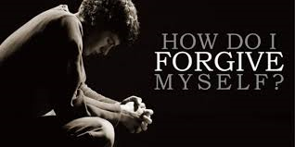
Kathryn Schulz On Regret
“The point is not living without regrets, the point is to not to hate ourselves for having them… We need to learn to love the flawed imperfect things we create and to forgive ourselves for creating them…. Regret [need not] remind us that we did badly… it reminds us that we can do better”
Notes:
You will see at the end of this presentation there are references to a series of you tube presentations.
Two are by Kathryn Schultz with regards to regret and being wrong....

Slide 7
Identify the Burden
Lean into distress and discover the values within….
Notes:
As indicated in the introduction, relational frame theory when added to self-forgiveness turns the lead or base metal of our distress into gold...
The worst of our circumstances can provide renewal and insights into a value life,
And still…

Slide 8
Notes:
No matter what the circumstances we know that we can instantly contact suffering and struggle and this provides an insight into the need for workable self-forgiveness.
So in the middle of apparently happy decisions….

Slide 9
Barry Schwartz: on choice
"when there is no choice, the world is to blame.
When there is too much choice I am to blame."
Notes:
Currently we find ourselves surrounded by world of choice and the fear of missing out is a new disease (FOMO in pop psychology).
Turning our experiences of that which should be joyful, into burdensome and sometimes despairing experiences.
Strange stuff turns up when we connect with new circumstances… losses, regrets, fears, unexpected outcomes…..
And then in the depths of despair we may blame ourselves for that which we cannot control

Slide 10
Decca Aitkenhead: on the loss of her husband
"self-blame restores order to a chaotic and random universe."
Notes:
We see in the autobiography of Decca Aitkenhead that a strange comfort was found in toxic self blame when there is no rational explanation for the loss of her husband.
This is very much the experience of the person whose personal circumstance we are using as a case study who had two levels of complex grief regarding the loss of a husband due to cancer and failure to conceive through a fertility program.

Slide 11
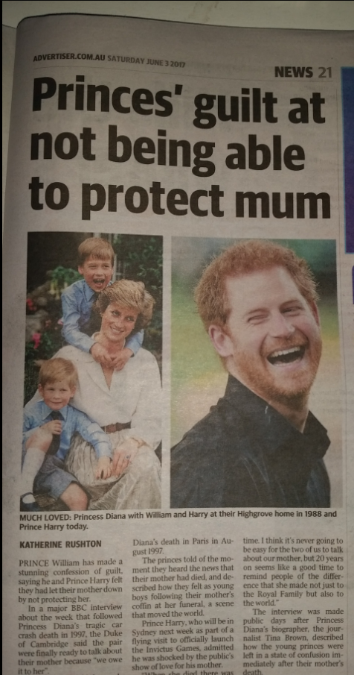
On the loss of a mother
“we were not able to protect her….”
Notes:
We see recently that two young men, one on the edge of puberty, one in their early teens could find no way to describe their loss - and blame themselves for loss of their mother.
And importantly decades later they are both recently acknowledging the importance of the experience regarding their mental health.
My client took unreasonable responsibility for her husbands fore-shortened experience of life and is now recognizing that burden

Slide 12
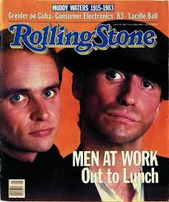
Colin Hays: On achievement
“ when you get what you want.. you find out that it is the end of something else…”
Notes:
An Australian group called Men at Work achieved the top of their profession, however when the song I come from the land down under achieved a status as the unofficial Australian national anthem they were sued for a technical breach of copyright.
The flautist Greg Ham who felt responsible for the breach (He inserted into the song a small piece) took his own life and Colin Hayes the song writer has experienced unspeakable grief.
However, the work done by Steve Hayes and many others demonstrates that with openness interest and curiosity we can turn incredible pain into purpose……

Slide 13
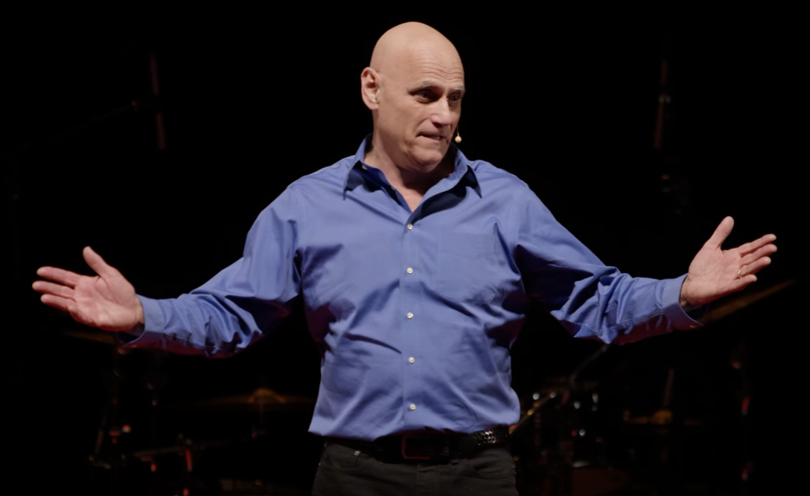
Steve Hayes: on love pain and purpose
“… we hurt where care and we care were we hurt….. These two pivots are the same thing…. bringing love to yourself even when it is hard, will help you bring love into the world”
Notes:
We know then that this experience can provide insight into distress, can reveal meaning in our pain and that we can find life in the midst of our struggle and suffering.
So by normalising our human experience we provide new means to discover our life values and how to apply them.....

Slide 14
Discovery
Every action serves a need….
How did we hurt ourselves?
What was the context and consequence?
To what extent do we now experience:
shame, guilt, self blame, regret, remorse?
What are to common responses when we contact with this burden
avoidance, withdrawal, other unworkable action….
Notes:
Please some time to note these points and reflect on them……

Slide 15
Take Perspective
Notes:
So now let's take time to breathe.
I invite you to take a relaxed posture and if you want to participate in this exercise just place your sight somewhere neutral or if you wish to gently close your eyes and just take time to breathe into your experience.
Whatever you are experiencing now it's okay to feel how you feel and I also invite you now just to bring your full attention to your breath.
Now just let your breath expand to fill your whole body…… now let your breath expand to fill experience of this room…… now let your breath expand to fill the experience of this convention the hotel and encompass all the people that are attending….. Please continue to expand your experience with your breath encompass this nation….. now expanding again and you can just gently as if standing on the moon, you can encompass in your breath the whole of the earth floating in space and
Just allow yourself to take perspective on the miracle of your experience in the context of the beauty and wholeness of the planet hanging in space
Now just open your eyes gently and notice in this picture of the rings of Saturn that tiny bright Point of light is our planet and consider its wonder and just take time to hold that perspective on the miracle of your experience in the context of that wonder.

Slide 16
A Stance - OPAL
Openness: Bring curiosity and interest to our experience
Presence: Lean into our experiences with compassion
Acceptance: Give unconditional positive regard to ourselves
Light: Shine a light in our darkness, and lighten the burden
To understand and respond to: Shame, Self-Blame, Guilt, Regret, Remorse
Notes:
And so we use various techniques within ACT to normalise the experience of the person and the uniqueness of their existence
We use the clinical application of the Relational Frame Theory to foster and encourage perspective taking

Slide 17
Where is the perspective?
I am here now
a higher experience
meaning and purpose
being compassionate toward varying experiences of our self
Story, Process and Context
Quick thinking versus Slow thinking
Imagination versus Knowledge
Mystery versus Certainty
Notes:
For example in this case study when the person is caught in the midst of the complex grief gently use reminders of I am here now to highlight their experience of being I am there now.
This gently allows them to take perspective on moves towards their grief and gives them confidence and reassurance that they love their husband and that this is ok.
And it is ok that it is not working right now……..

Slide 18
ACT/RFT approaches to exploring self forgiveness Engaging in a forgiving internal dialogue:
How would you take a perspective that helps to understand:
who you were at the time of the transgression
what your intentions were, and,
the unintended effects of your actions
What values are hidden in the struggle and pain?
How might perspective transform this experience?
Notes:
I think this is an important piece in terms of Carmen Luciano’ s concept of Coherence and allowing a whole sense of self into the process of becoming more flexible into responding to oneself through self forgiveness.
In Loss there are values of Love and companionship loyalty etc…….
In self criticism over termination and miscarriage there is the value of being a mother, connection, care and contribution……
In loneliness there is the value of productive and life giving relationship…….

Slide 19
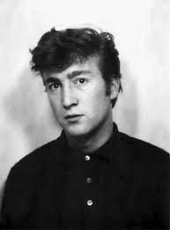
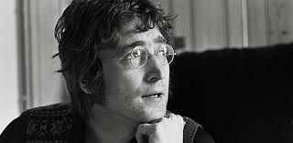
John Lennon: On life and chaos
“Life is what happens when you’re busy making other plans”
Notes:
So for example, When our client in the case study was going through the time, hardship and regret of a failed experience of fertility treatment,
Much emotional effort/investment was being placed into that experience over many years…..
and then
Cancer struck her husband and he was swept quickly out of her life causing a whole new depth of regret.

Slide 20
Using Relational Frames
How else can I view this? Perspective taking
How is this Like That? Coordination
How does this cause that? Contingency/Causality
Is this better or worse than that? Evaluative
How does this fit/contribute/build on that? Hierarchical
Notes:
So in using the clinical application of relational framing we would use questions such as
Perspective taking
if we took the point of view of your husband would he want you to be suffering as badly as this?
Coordination
would you talk to a friend like you talk yourself?
Hierarchical
Does your current stance regarding friends with children fit with your values about children?

Slide 21
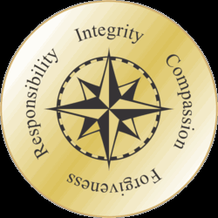
Values and Pathways
Values are the compass
to find our way out of the swamp
of unforgiveness toward ourselves
Notes:
When bringing together the literature on self forgiveness we know that the key to genuine self forgiveness is one that is based on contacting implementing and responding to values.
This is required in both forgiveness in the context of external offence but also is the case for intrapersonal offence an areal that has not been well identified and studied until now.
Contextual behavioural science fills a key gap with regards to intrapersonal transgression and the observations of Robert Zettle build on research into self forgiveness by Hall, Fincham, Dillon, Holmgren Woodyatt and Wenzel (see references)
Dillon, R. (2001). Self-forgiveness and self-respect. Ethics, 112(1), 53-83.
Hall, J., & Fincham, F. (2005). Self-forgiveness: The stepchild of forgiveness research. Journal of Social and Clinical Psychology, 24(5), 621-637.
Holmgren, M. (1998). Self-forgiveness and responsible moral agency. The Journal of Value Inquiry, 32(1), 75-91.
Woodyatt, L., & Wenzel, M. (2014). A needs-based perspective on self-forgiveness: Addressing threat to moral identity as a means of encouraging interpersonal and intrapersonal restoration. Journal of Experimental Social Psychology, 50(1), 125-135. doi:10.1016/j.jesp.2013.09.012
Zettle, R., Barner, S., & Gird, S. (2009). ACT with depression: The role of forgiving. In J. T. Blackledge, J. Ciarrochi, & F. Deane (Eds.), Acceptance and Commitment Therapy: Current directions (pp. 151- 173). Bowen Hills QLD: : Australian Academic Press.

Slide 22
A values perspective provides a reference point to:
Understand the context of the transgression
Identify to what extent a transgression contravened our values
Understand that the process of contact with painful experiences needs a values based perspective
Notes:
So the work we find in ACT and clinically focused RFT provides the evidence-based pathway that recent researchers have been seeking
ACT/RFT provides established therapeutic pathway to the application of values and their implementation to provide a workable response to distress.
The mindful application of values in response to suffering and struggle without pathologizing normal human responses, provides a trans diagnostic approach to a wide variety of human experience where people struggle to forgive themselves
Loss and grief, overwhelming and poorly understood anxiety, unexplained depression - e.g. graduate students, not good enough stories and imposter syndrome (https://www.youtube.com/watch?v=XHGBeg6AnMo )

Slide 23
Values Inventory examples…..
Assertiveness to respectfully stand up for my rights and request what I want
Authenticity to be authentic, genuine, real; to be true to myself
Compassion to act with kindness towards those who are suffering
Courage to be courageous or brave; to persist in the face of fear, threat, or difficulty
Freedom to live freely; to choose how I live and behave, or help others do likewise
Friendliness to be friendly, companionable, or agreeable towards others
Honesty to be honest, truthful, and sincere with myself and others
Love to act lovingly or affectionately towards myself or others
Mindfulness to be conscious of, open to, and curious about my here-and-now experience
Trust to be trustworthy; to be loyal, faithful, sincere, and reliable
Notes:
When we examine people's distress will often see that within the thing that they are trying to move away from , it may contain indicators of their values.
For example
loss and grief may indicate love and life purpose,
I hate the way people look at me and are talking about me may indicate needs for respect and relationship in community
Also when moving toward their values un expected things may get in the way…
Health
You mean when I want to be healthy I actually have to eat better and exercise…… consistently???????

Slide 24
Using Values to build pathways
We can Identify how we may have ignored our values, or,
How values may have been in conflict
Acknowledgement of values allows us to:
Provide a values based explanation of our behaviours and responses
Identify how we may be conflicted in our values and behaviors
Recognize our avoidances and excuses
Admit and take genuine responsibility
Provide a validation of our concern regarding the consequences
Notes:
For example in a case study, self protection from further hurt and loss, is in conflict with a love of children and need for relationship in family and community.
These example provide indicators for how to use ACT and RFT for openness presence acceptance and lightness to be brought to bear on this experience and to provide psychologically flexible responses.

Slide 25
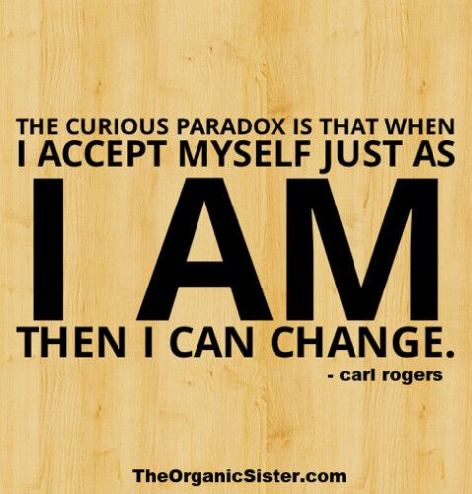
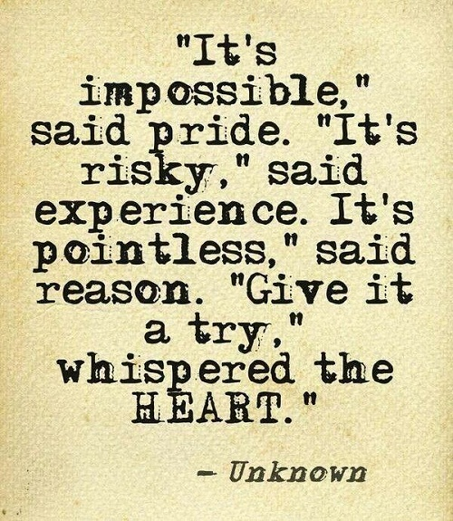
Getting unstuck

Slide 26
Getting Unstuck: Psychological Flexibility
The Self as Observer
Acceptance / Willingness
Valued Living
Psychological
Flexibility
Defusion /
Watch your thinking
Committed Action
Being Present
Living in the here and now

Slide 27
ACT and Clinically focused RFT
In the Present Moment
Take time to get in touch with what is going on right here and now
Take notice of your breath for 3-5 minutes
Values
Identify your key values, How could you live more in line with them
Have you neglected anything that is important for things that are not important?
Defusion on your stories/hot thought
As you go about your day be mindful of those thoughts which are unworkable
Practice letting go of those thoughts that are not useful
The Observant Self
Meditate on observing your thoughts without getting bound up in them
Perspective exercises – How is this like or not like that? How would another view this? How would you see this in five years? How does this build on or subtract form your values?
Willingness
Make room for uncomfortable thoughts feelings sensations
Committed action
Take action to live out your values in one key area today
Notes:
A present moment focus
was used to identify sorts feelings and bodily sensations experience when consumed by grief and in that moment to use the breath as a means by which to focus on the shift of attention from that experience that is seemingly overwhelming.
A values-based exercise
for our client was to refocus on healthy eating and exercise
A defusion strategy
was to notice and name various self talk stories about relationship.
An observant self strategy
was to notice the frequency of harsh judgement and criticism and to name its and transform it.
A willingness strategy
was to make room for uncontrolled crying in session for over 10 minutes allowing space for discomfort and distress
A committed action
was to contact a friend with children and catch up with them and discuss her journey so far

Slide 28
Getting unstuck Utilizing the ACT Matrix…
Notice how inner world experiences relate to outer world behaviors
Values vs Stuff that gets in the way
Moves away and moves towards
Identify how painful experiences (moves away) can also be used to highlight and clarify values
Identify pathways for valued and committed action (moves toward)
Use Relational frames understand experiences within oneself
Notes:
The application of the act matrix allows everything into the room with openness interest and curiosity and makes room for a free and open examination of how things are working when tough stuff shows up.
The open and compassionate application of the matrix allows everything to be flexibly dealt with.

Slide 29
The ACT Matrix of Self Forgiveness
Outer World Experience
5 Senses Experience
Moves away from unwanted stuff
Moves toward what or who is important to you
Aversive Control
Appetitive Control
Struggle actions
Committed actions
Away Moves
Toward Moves
Suffering
Values
Inner Obstacles unwanted stuff that shows up:
Shame, Guilt, Self Blame,
Regret, Remorse
Who or what is important to you
Restoration
Reconciliation
Repair
Self Acceptance
Self Compassion
Self Forgiveness
Examples of
Value domains
Intimate Relationships
Family
Parenting
Leisure
Work
Social Relationships
Education Training
Culture Citizenship Community Self-Care Health
Spirituality
Work
Mental Experience
Inner World Experience
(Wilson, Polk, & Schoendorff, 2014)
Notes:
In the case study one simple area of who or what was important was the area of relationship with children.
Internal Values
It was important to the ME of our client - she loved children
It was important in the context of family and community
It was a value that involved self acceptance, self compassion and self forgiveness
Values external moves toward
Her move towards was to get in contact with a friend who had a child of a significant age that is the equivalent age to a child that she had lost due to miscarriage.
When noticing inner obstacles
she was concerned about being judged about being shamed publicly and it reminded her of her failure to have a child with her husband.
When making external moves away
she noticed that she ate compulsively and
She put off travelling to the location of the family despite having important business there and that she then felt physically exhausted and did not engage in other activities such as exercise walking

Slide 30
Granting Self-Forgiveness
How would you speak to a child who was hurt and who needed support and guidance?
How do you speak to yourself ?
Notes:
Frequently, taking the stance of the child and their needs provides a open and flexible response to this need to grant self forgiveness.

Slide 31
Michelle Charfen: on self-acceptance
“we can't accept others when our acceptance of ourselves is conditional … realize that its ok to focus on what you want … find your limiting beliefs and instead of running away from them delve into them”
Notes:
the need for self-forgiveness is universal and probably as old as human consciousness

Slide 32
J.K. Rowling: on failing
“The benefits of my failure….. meant the striping away of the inessential…. I stopped pretending to myself that I was anything other than what I was…. and began to direct all my energy into finishing the only work that mattered to me… I was set free as my greatest fear had been realized and I was still alive… and I had a big idea….”
Notes:
Self-forgivenessIs central to the effort of change in creativity, because in order to make change in order to live an experience
we must be able to get it wrong and to recover.
We must make mistakes and sometimes make fools of ourselves…..
to live out that life of meaning and purpose

Slide 33
Sir Ken Robinson: on being wrong
children are creative because they are prepared to get it wrong
"if you're not prepared to be wrong you will never come up with anything original…”
Notes:
To embrace a life with child like wonder and to be prepared to get messy and dirty we need to get things wrong……
And just like the values of self acceptance and self compassion,
Self-forgiveness needs to be constantly revisited and renewed as our circumstances change we find that we have made mistakes and we find reasons for regret.

Slide 34
Granting Self-Forgiveness
Having compassionately:
Identified our transgression and experiences of Shame, Guilt, Regret and Remorse
Acknowledged effects and harms
Taken responsibility for behaviours that don’t work
Reviewed our values
Worked through development of workable perspectives
We then start the journey of values-based self-forgiveness
Ongoing self-forgiveness is confirmed by active responses

Slide 35
Kathryn Schulz: on mistakes, regret and being right
“we need to forgive ourselves for not making mistakes… we need to embrace our regrets … and to rediscover wonder … we need to step out of the tiny terrified space of rightness”

Slide 36
Creating an Action plan
Respond to discoveries…
Restitution
Renewal
Recovery
Reconciliation

Slide 37
Self-forgiveness that lasts requires action
Ongoing affirmation through self compassion, self acceptance and self worth
Committed action that acknowledges self-discovery
Taking consistent steps that move towards values
Apply the ACT Matrix for self-forgiveness to daily experience

Slide 38
Self-forgiveness that lasts requires action
Develop SMART goals for values based action for Restitution, restoration, repair and renewal……
What can I specifically do?
How do I measure it?
Is it achievable?
How is it relevant?
By what time?

Slide 39
An ongoing commitment to self-forgiveness
Life continues to happen
Notes:
As we have seen reported in both the UK and Australia Prince Harry has only recently acknowledged the depth of this distress regarding his experience of the loss of his mother.
He had realised that his own experience of denial had been a reflection of the ongoing normality in which the palace that operated as usual in the presence of his mother's death
he and his brother had to ask was mummy really dead?
Having experienced this erasure of his mother's passing he subsequently did this to some extent his own life.
It is only recently with new insight that he has acknowledged his own need for restoration and renewal and psychological support

Slide 40
Keith Richards: On dreams
“for years you want your dreams to become true, and all that happens is that your dreams become real”
Notes:
Even when life goes well….
As Darrin Cairns observes in the successful treatment of Autism Spectrum Disorder, new insight brings new consciousness and consequently distress and needs to respond to life’s setbacks

Slide 41
As we free ourselves we find new territory
A new sense of ourselves can bring a danger of overwhelming regret … why did I not do this years ago … ?
New challenges, new responsibilities, new discoveries will require new responses ...
Then we need to put the principles into action …
Notes:
New Territory brings new challenges and new necessities to get things wrong…..

Slide 42
Revisit and review the principles of Self-Forgiveness
Identify our transgression
Take Perspective
Revisit our values
Get Unstuck
Grant ourselves Forgiveness
Values for Action
Make a commitment to ongoing Self Forgiveness

Slide 43
Brene Brown On Showing up
“It is not about winning, it is not about losing, it's about showing up and being seen”
Notes:
In this scene a person has put aside their performance time for the London marathon to help a heat struck fellow runner to complete his distance……

Slide 44
Action for ongoing Self Forgiveness:
Review your SMART goals
Continue to develop choice points for future situations which involve the same contexts or experiences
Establish alternate pathways for relapse prevention
Notes:
See actmindfully.com.au

Slide 45
Cultivating a forgiving internal dialogue
Continue to develop a compassionate presence, self-acceptance and self-respect
Accepting that things are what they are and being willing to find a way through
Coach yourself to respond to yourself with values-based self forgiveness that helps you live a flexible and responsive life

Slide 46
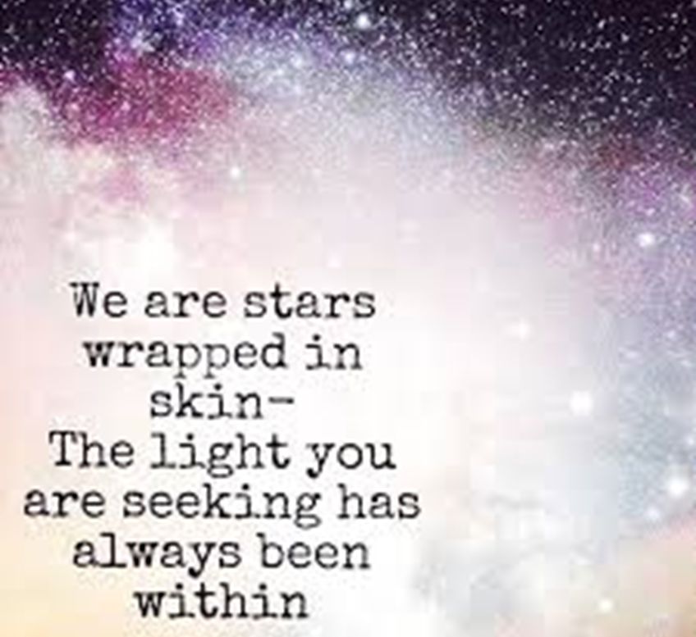
On the wonder of self-forgiveness
I accept myself just as I am, perfect in my imperfection,
I am now willing to take action in this state of self acceptance and am willing to go through what I need to do … so that I can be what I value

Slide 47
Results: Australian Research Scholarship
3 Case studies individuals with Multiple Comorbidities including alcohol abuse and, or, excessive prescription drug use and chronic pain
Resolution and relapse prevention – now 2- 3 years sober and living a valued life
Presentation to Allied Health professionals with a thematic analysis – embraced ACT with Self Forgiveness as a useful intervention for stuck cases
Comparative Intervention ACT n=60 ACT SF n= 66, as follows:

Slide 48
Comparative Intervention ACT n=60 ACT SF n= 66

Slide 49
Comparative Intervention ACT n=60 ACT SF n= 66

Slide 50
Comparative Intervention ACT n=60 ACT SF n= 66

Slide 51
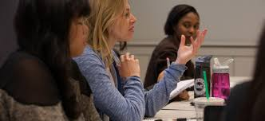
Questions?

Slide 52
Complex Grief | Case Study
Presentation: | 47 years of age, complex grief due to loss of husband to cancer after extensive failed IVF I now really regret IVF program failure and infertility I feel I do not respect myself I am lonely but I do not want to get over my husband I avoid friends with children
History : | Grew up in on farm - complex relationship with parents, experience of childhood sexual abuse by farm employee. Not reported, no action taken. Worked in public sector and health care. Engaged in active sex life from age of 18 ( had one termination - revealed at session 10).At age 28 met husband (40 yoa) with grown children Tried for pregnancy, no success 13 cycles of IVF, one miscarriage. Ceased effort at age 38. Husband diagnosed with cancer when she was 40, he died when she was 43
Health : | Overweight but active

Slide 53
Describing
Please try to describe without judging it as being it being either good or bad what is this experience | I am consumed by loss and grief about my husband due to cancer I have honoured him by staying single ( even though he gave me instructions to remarry) and undertaking journeys, through the centre of Australia from South Australia up to Queensland in a four-wheel-drive and caravan. I am now really regret IVF program failure and am reflecting on my regret about the termination of my pregnancy at age 18 I feel I do not respect myself, I am lonely but I do not want to get over my husband
Present moment attention
Lean into Distress describe discomforting thoughts, emotions and bodily sensations. | Feel frozen by grief, unable to speak, lump in the throat, tears Rising sense of panic at the thought of being judged by others Fearful of being seen as being unfaithful, and being talked about as a bad person for my decisions.

Slide 54
Principles | Entering into Self Forgiveness
What are these Burdens? | Mourning and grief for husband Fighting with accepting permission for a new relationship Deep regret regarding termination and loss of opportunity for motherhood
How might these reveal your values | Building respect, healthy relationship, freedom in sexuality, connection
Perspective taking. | Taking the stance of her husband Noticing moves towards values moves away - noticing inside and outside rules. If this happened to a friend what response? Looking at achievements/values….. Honour, faithfulness, journeys
Getting unstuck | Using the ACT matrix take perspective on responding under the experience of shame and guilt, regret and remorse. What happens in the outer world When working in line with values. What might happen in the outer world
Grant self-forgiveness | Acknowledge worth with self-acceptance genuine self-love and compassion Grant self forgiveness through compassionate presence with herself Naming the losses. Reconciling with herself and with her former husband Giving herself permission for new relationship
Valued action | Visiting the grave of her husband to talk through her reconciliation Commencing dating, Reconnecting with friends with children.
Commitment to self-forgiveness | Daily mindfulness journaling experiences of self-acceptance and ongoing noticing of responses to life - applying to dating

Slide 55
When you are comfortable with both
your strengths and weaknesses,
you radiate simple unaffected humanity.
Self acceptance total self acceptance
means self forgiveness.
When you forgive yourself and stop judging yourself -
then you won’t judge others and there will be less conflict in the world. @ feelgoodtribe.com

Slide 56
The Reality Slap, Dr Russ Harris, ACTMindfully.com Embracing your Demons: https://www.actmindfully.com.au/upimages/Dr_Russ_Harris_-_A_Non-technical_Overview_of_ACT.pdf
Steve Hayes Founder of Acceptance and Commitment Therapy Psychological flexibility: How love turns pain into purpose https://www.youtube.com/watch?v=o79_gmO5ppg
The secret to self control | Jonathan Bricker | TEDxRainier https://www.youtube.com/watch?v=tTb3d5cjSFI
Mental Brakes to Avoid Mental Breaks | Steven Hayes https://www.youtube.com/watch?v=GnSHpBRLJrQ
Clinical Relational Frame Theory (RFT) Video demonstration https://contextualscience.org/clinical_rft
Self-Acceptance: The Compassionate Alternative to Self-Esteem https://contextualscience.org/wc13_powerpoints_handouts
Unconditional positive regard -- the power of self acceptance | Michelle Charfen https://www.youtube.com/watch?v=4tkkL9w2pw8
What is the ACT Matrix https://www.youtube.com/watch?v=O3NuoQrCClY
Kelly McGonigal How to make Stress Your Friend https://www.ted.com/talks/kelly_mcgonigal_how_to_make_stress_your_friend?language=en
Dan Ariely Self Control https://www.youtube.com/watch?v=PPQhj6ktYSo
Kathryn Schulz: On being wrong https://www.ted.com/talks/kathryn_schulz_on_being_wrong
Kathryn Schulz: Don't regret regret https://www.ted.com/talks/kathryn_schulz_don_t_regret_regret
Jonathan Haidt: Religion, evolution, and the ecstasy of self-transcendence Http://www.ted.com/talks/jonathan_haidt_humanity_s_stairway_to_self_transcendence?language=en
Ken Robinson: Do schools kill creativity? https://www.ted.com/talks/ken_robinson_says_schools_kill_creativity?language=en
Brene Brown: The power of vulnerability www.youtube.com/watch?v=iCvmsMzlF7o
Brené Brown: Listening to shame https://www.youtube.com/watch?v=psN1DORYYV0
Brené Brown: The price of invulnerability: https://www.youtube.com/watch?v=_UoMXF73j0c
Brené Brown: Why Your Critics Aren't The Ones who count www.youtube.com/watch?v=8-JXOnFOXQk
Bravery & Authenticity in a Digital World /w Brené Brown | Chase Jarvis https://www.youtube.com/watch?v=cUuXDZERxrk
Daring Greatly to Unlock Your Creativity with Brené Brown https://www.youtube.com/watch?v=kAk4cwjvJ0A
J.K. Rowling Speaks at Harvard Commencement https://www.youtube.com/watch?v=wHGqp8lz36c
Natalie Portman Harvard Commencement Speech https://www.youtube.com/watch?v=jDaZu_KEMCY
How To Skip the Small Talk and Connect With Anyone | Kalina Silverman https://www.youtube.com/watch?v=WDbxqM4Oy1Y

Slide 57
Bailey, A., & Harris, R. (2014). The Weight Escape: Penguin UK.
Enright, R. D. (1996). Counseling within the forgiveness triad: On forgiving, receiving forgiveness, and self-forgiveness. Counseling and Values, 40(2), 107-126.
Exline, J. J., Root, B. L., Yadavalli, S., Martin, A. M., & Fisher, M. L. (2011). Reparative Behaviors and Self-forgiveness: Effects of a Laboratory-based Exercise. Self and Identity, 10(1), 101-126. doi: 10.1080/15298861003669565
Fisher, M. L., & Exline, J. J. (2006). Self-forgiveness versus excusing: The roles of remorse, effort, and acceptance of responsibility. Self and Identity, 5(2), 127-146. doi: 10.1080/15298860600586123
Harris, R. (2009). ACT made simple. New Harbinger.
Hayes, S., Wilson, K., & Barnes-Holmes, D. (2001). Derived relational responding is learned behaviour. In S. Hayes, D. Barnes-Holmes, & B. Roche (Eds.), Relational Frame Theory. A Post-Skinnerian Account of Human Language and Cognition. Hingham, MA, USA: Kluwer Academic Publishers.
Hayes, S. C., Strosahl, K. D., & Wilson, K. G. (1999). Acceptance and commitment therapy: An experiential approach to behavior change: Guilford Press.
Luoma, J., & Platt, M. (2015). Shame, self-criticism, self-stigma, and compassion in Acceptance and Commitment Therapy. Current Opinion in Psychology, 2, 97-101. doi:http://dx.doi.org/10.1016/j.copsyc.2014.12.016
Slocum, D., Allan, A., & Allan, M. M. (2011). An emerging theory of apology.Australian Journal of Psychology, 63(2), 83-92.
Törneke, N. (2009). Relational Frame Theory. Stockhol: Student litteratur AB.
Tutu, D., & Tutu, M. (2014). The Book of Forgiving: The four fold path for healing ourselves and the world (D. Abrahms Ed. Vol. William Collins). London UK: W.
Villatte , J & Villatte M (2013) Clinical RFT: Building Meaning and Motivation ACBS World Conference, Sydney 2013 https://contextualscience.org/files/25%20Clinical%20RFT%20Meaning%20and%20Motivation%20-%20Villatte%20&%20Villatte.pdf Jennifer & Matthieu Villatte (jlvillatte@gmail.com & matthieu.villatte@gmail.com)
Wenzel, M., Woodyatt, L., & Hedrick, K. (2012). No genuine self-forgiveness without accepting responsibility: Value reaffirmation as a key to maintaining positive self-regard. European Journal of Social Psychology, 42(5), 617-627. doi: 10.1002/ejsp.1873
Woodyatt, L., & Wenzel, M. (2013). Self-Forgiveness and Restoration of an Offender Following an Interpersonal Transgression. Journal of Social and Clinical Psychology, 32(2), 225-259. doi: 10.1521/jscp.2013.32.2.225
Worthington, E. L., & Scherer, M. (2004). Forgiveness is an emotion focused coping strategy that can reduce health risks and promote health resiliency: Theory, review and hypotheses. Psychology and Health, 395-405.
Zettle, R., Barner, S., & Gird, S. (2009). ACT with depression: The role of forgiving. In J. T. Blackledge, J. Ciarrochi, & F. Deane (Eds.), Acceptance and Commitment Therapy: Current directions (pp. 151- 173). Bowen Hills QLD: : Australian Academic Press.

Slide 58
Sevilla Muchas Gracias! Adios
Grant Dewar grantdewarpsychlogist@gmail.com
Peter Strelan
Paul Delfabbro
The University of Adelaide

